Slide 1


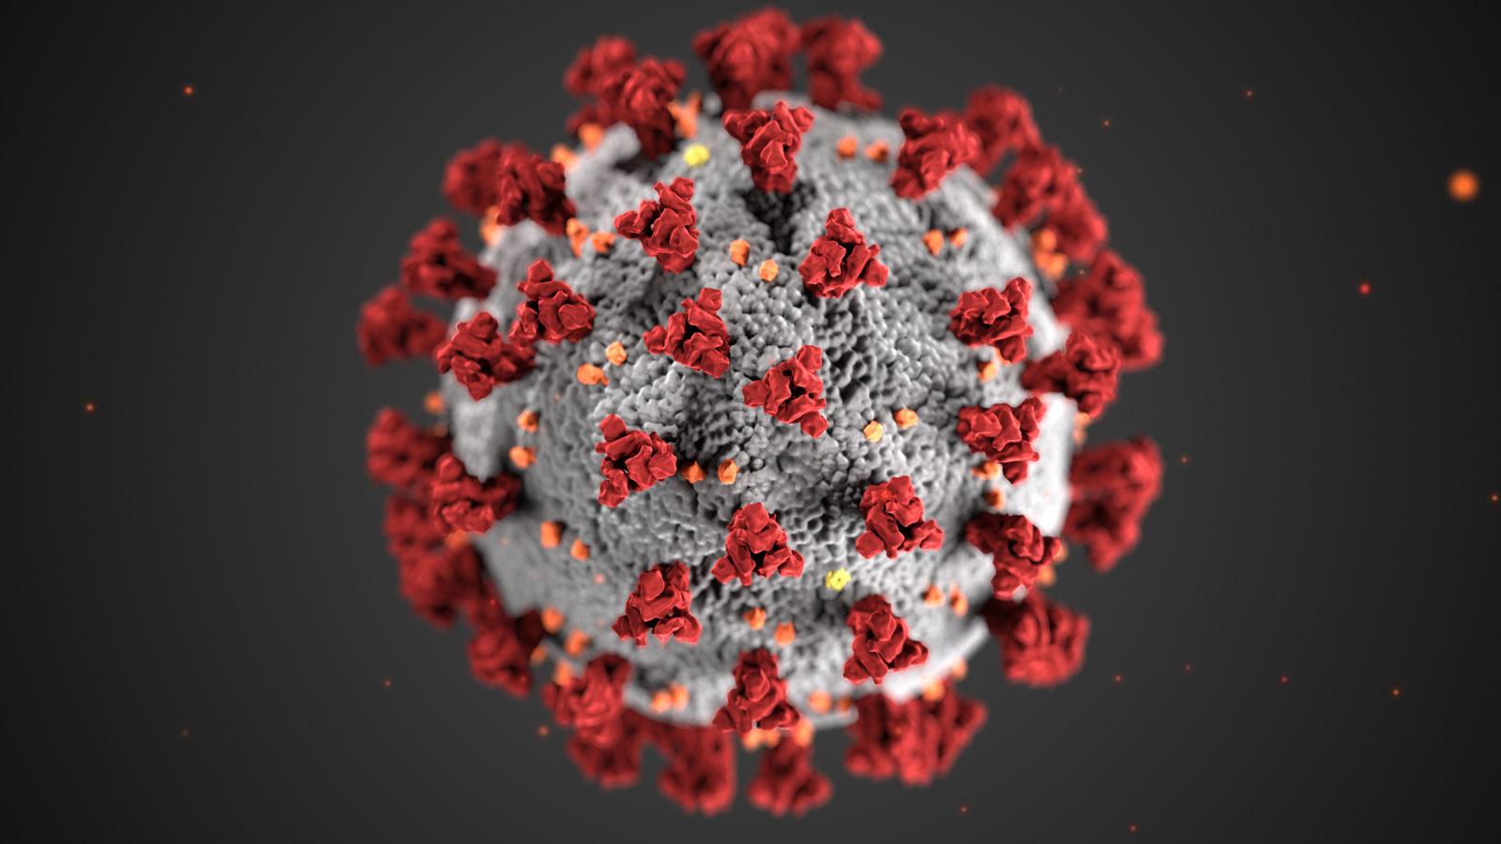
DE15 Report Presentation
George
Kate
Joao
Ross
Chris

Slide 2
Brief
“Consider the impact that winter may have on the health care , primarily the hospital (acute care) sector. To what extent is the ‘winter crises’ the media predicts a real? How has winter impacted NHS Scotland’s hospital system in the past? Why might it be even more critical in the coming year and might the pandemic influence the potential scenario.”

Slide 3
Intent of our report
Impact of Covid on secondary care over time and by health board
Impact of Covid on demographics
Geographic variation
Representation in Shiny dashboard

Slide 4
KPIs
Number of admissions
Bed occupancy
Length of stay/episode

Slide 5
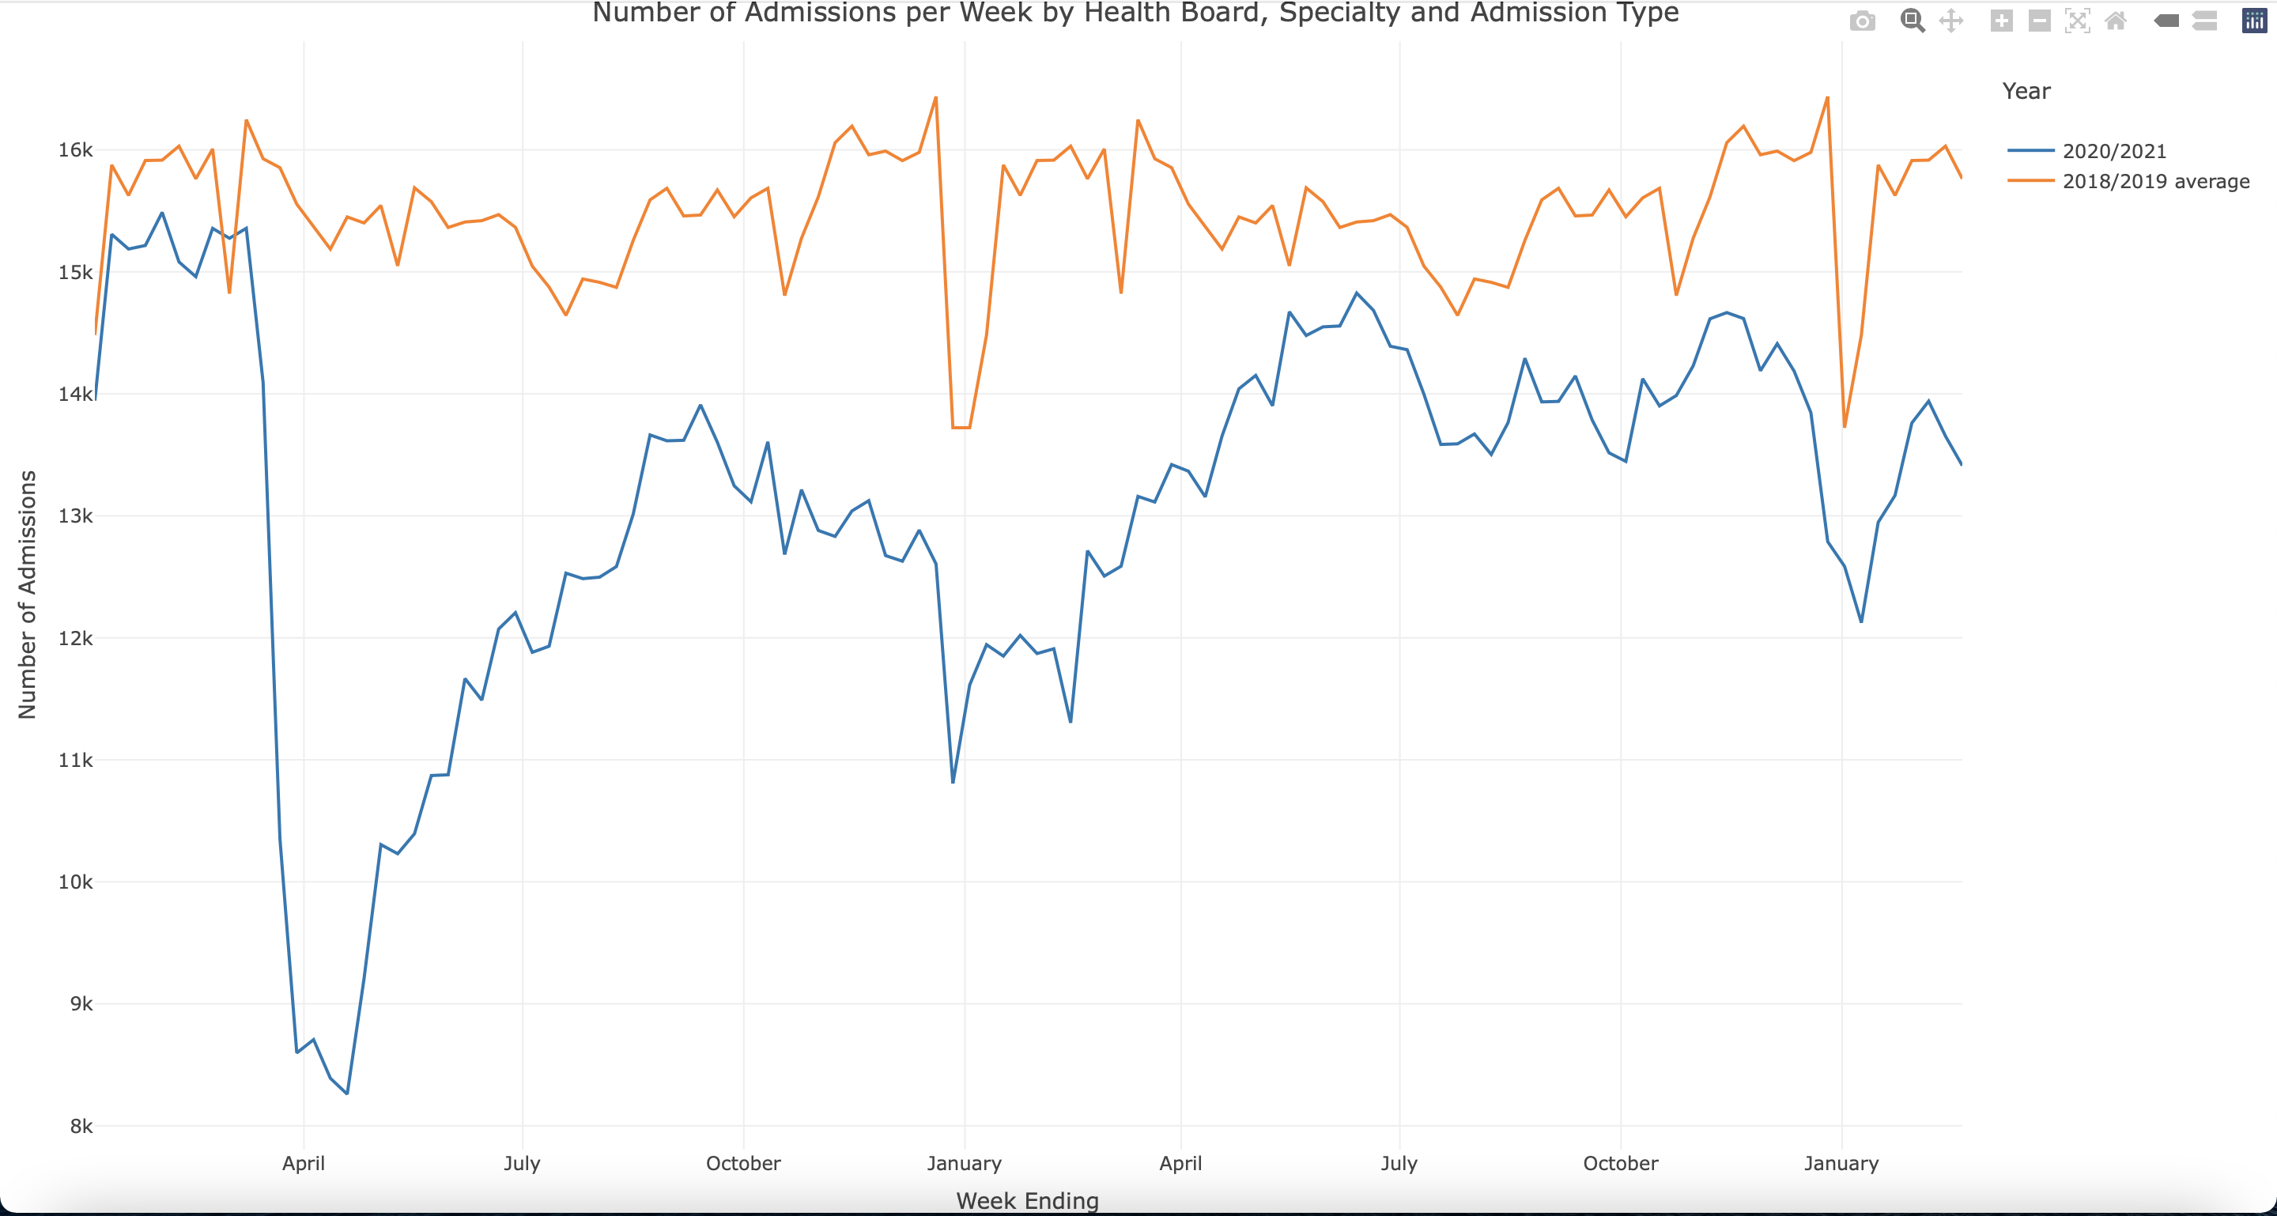
Insights
Overall drop in hospital admission numbers

Slide 6
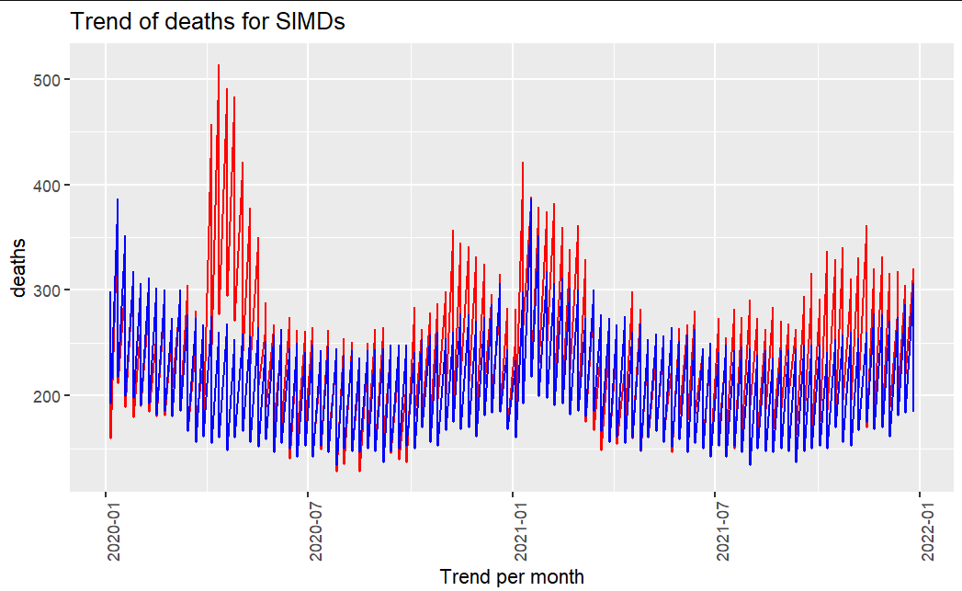
Insights
Excess deaths
Average death trend from 2015 to 2019
Average death trend from January 2020 onwards

Slide 7
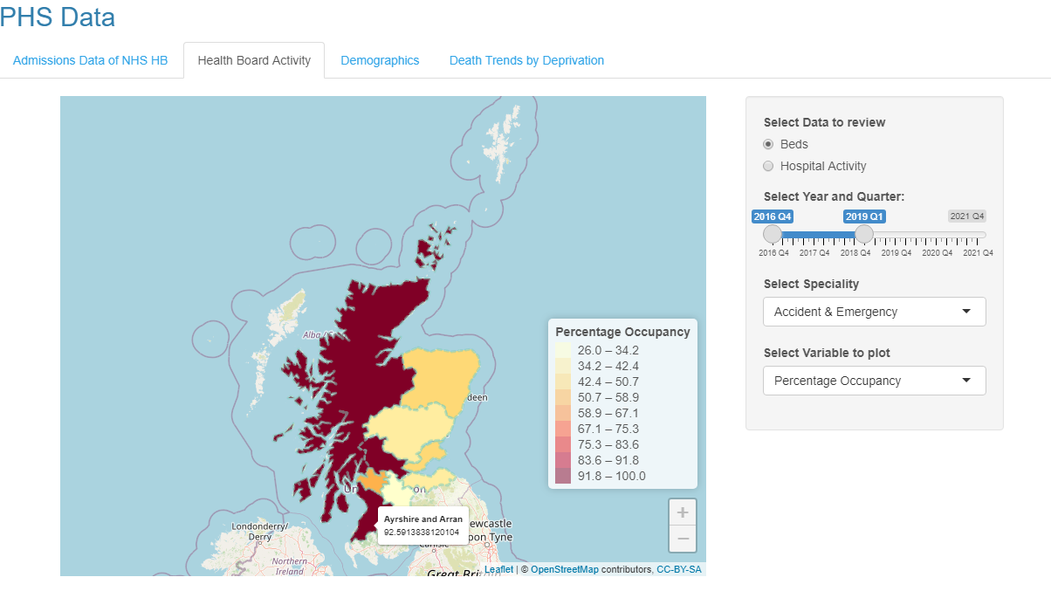
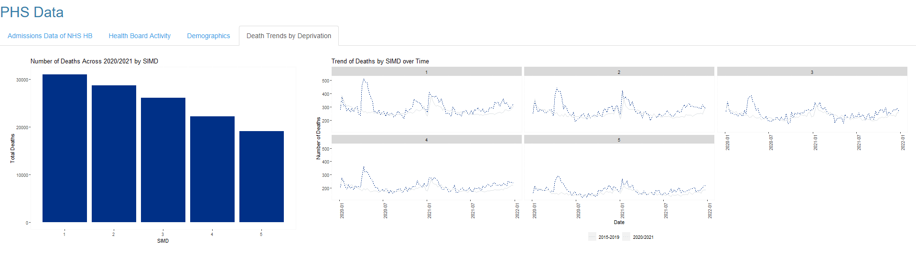
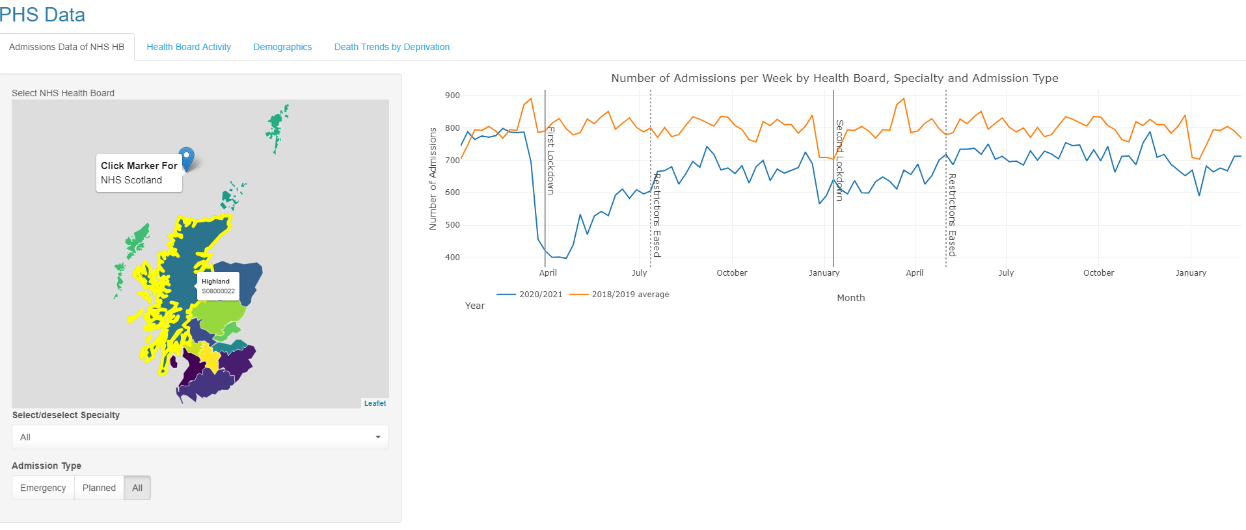
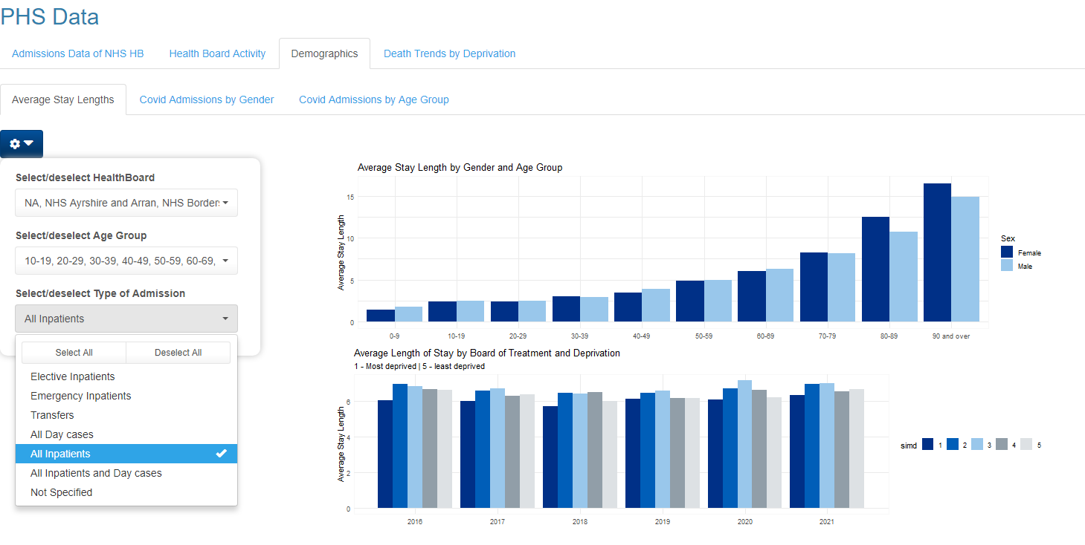
Shiny Dashboard

Slide 8
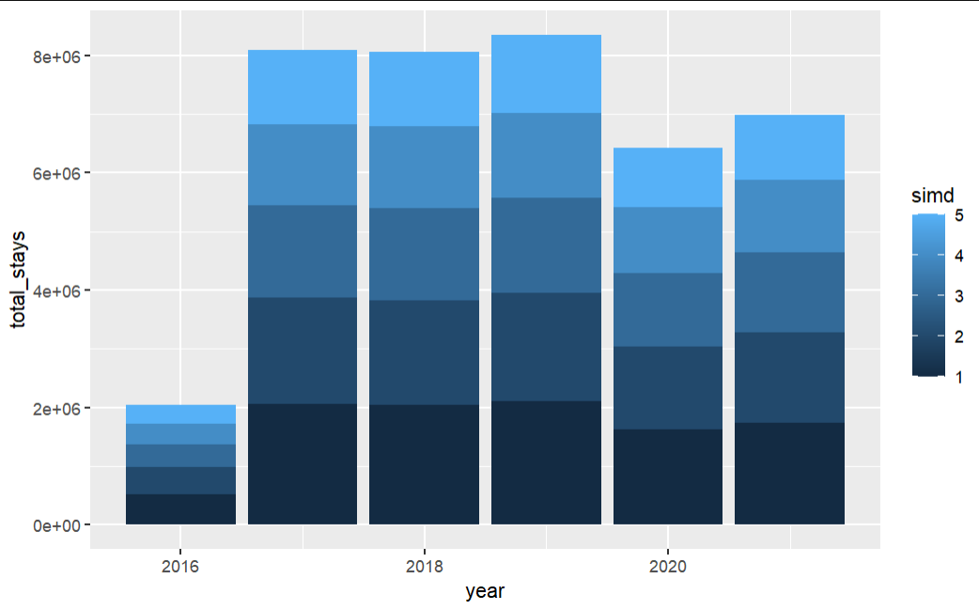
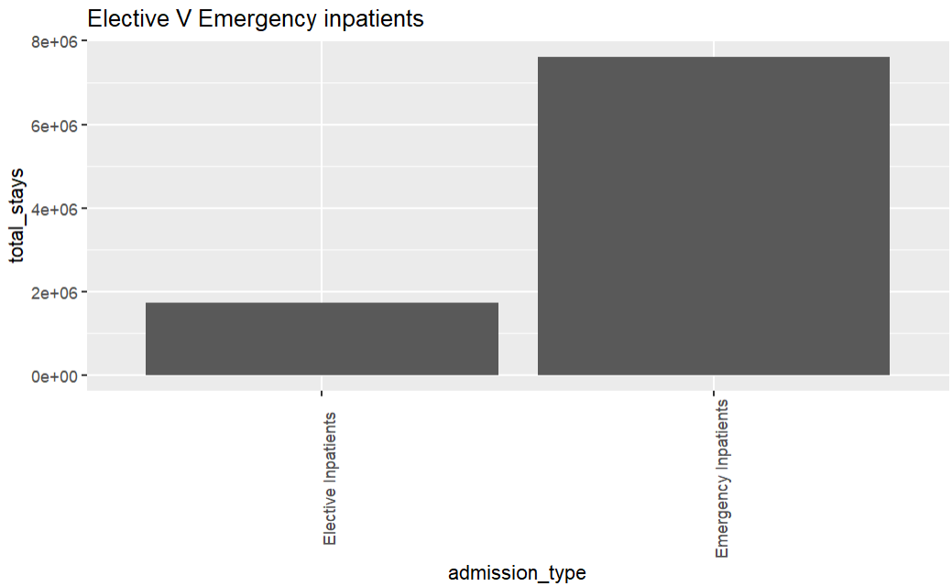
Impact on Demographics

Slide 9
Map of Impact

Slide 10
Temporal data

Slide 11
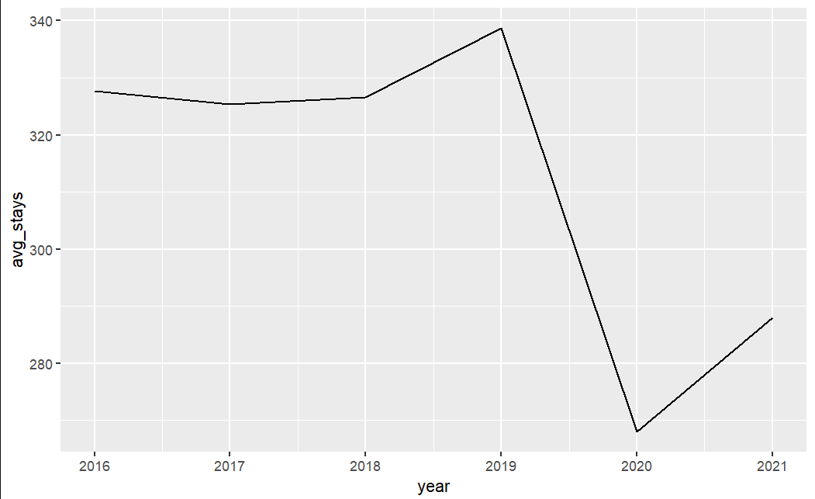
Trend of stays

Slide 12
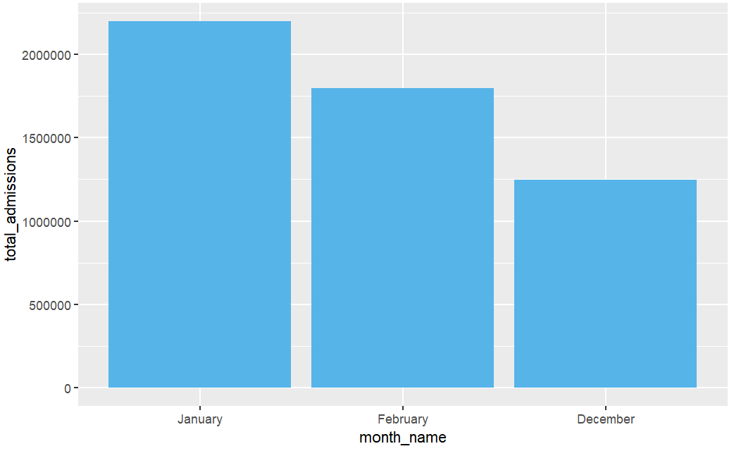
Impact of Winter

Slide 13
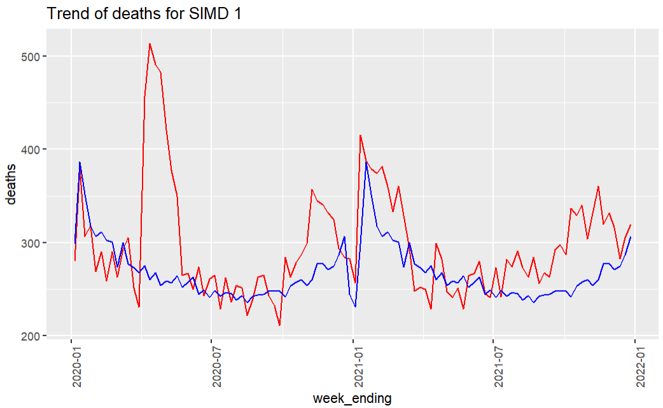
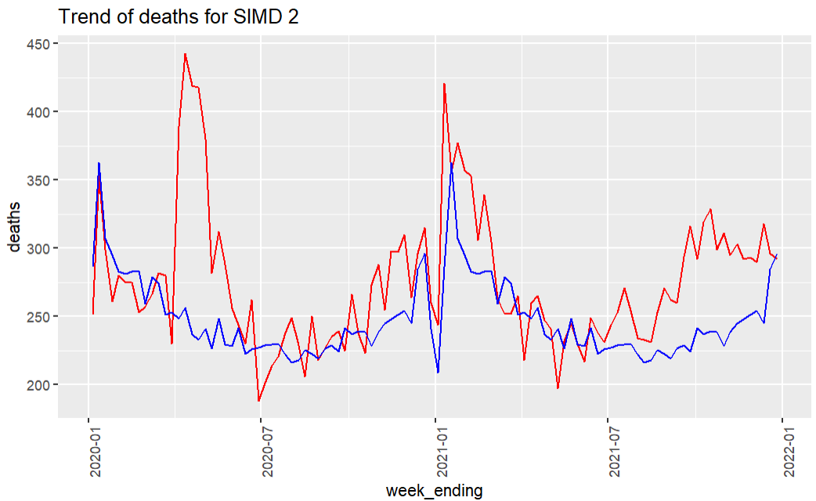
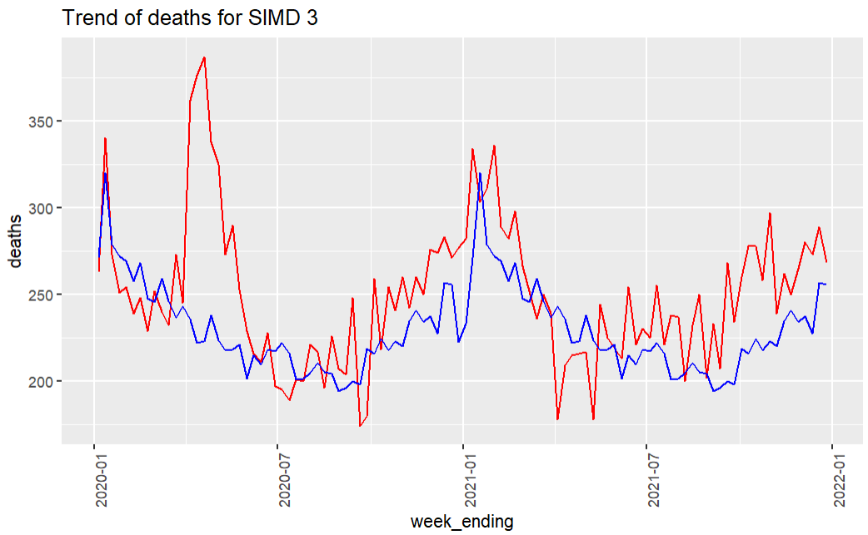
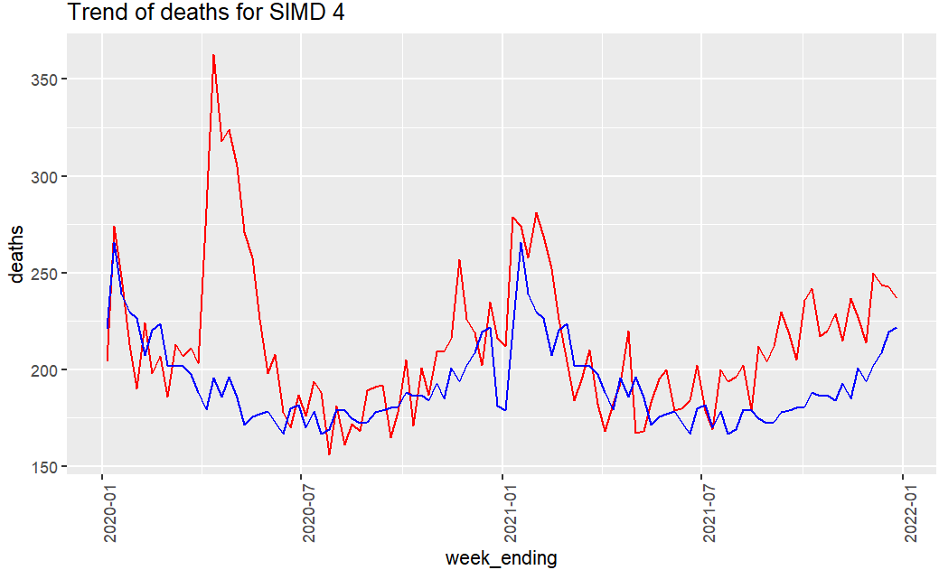
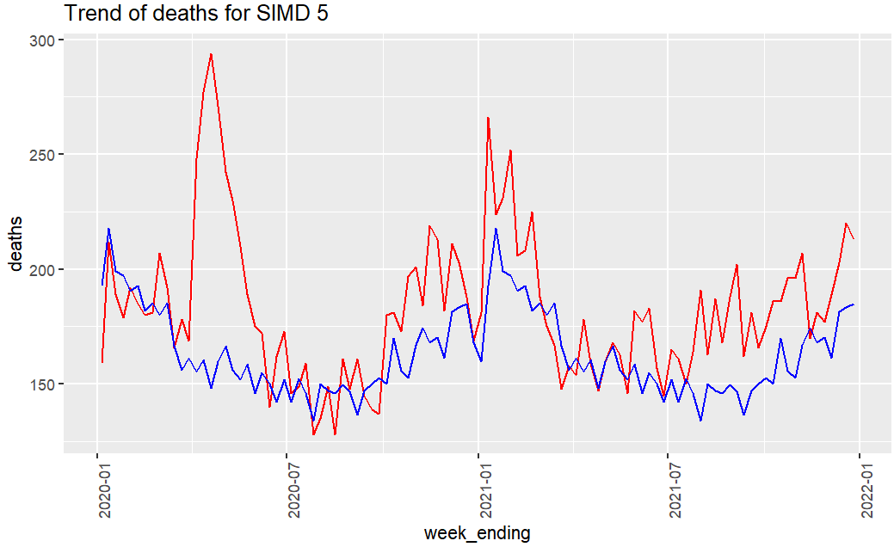

Deprivation

